Slide 1
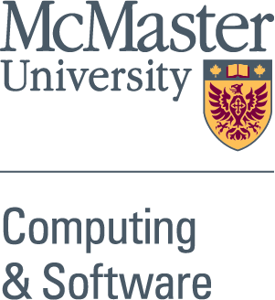


Information Encoding and Traceability in Software
Drasil – Generate All the Things!
Anthony Hunt, Dr. Jacques Carette, Dr. Spencer Smith
Department of Computing and Software, McMaster University, Hamilton, ON, Canada
Introduction
Methods
Results
The Big Idea
Easily generate and change documents.
Errors were pervasive and much easier to fix.
Low time investment needed to create new projects.
Flexible enough to create other types of documents.
Recipes rely on many embedded Domain-Specific Languages.
Software should be created by using a rational document-driven design with a focus on communication.^{[1]}
Using a structured design will increase developer productivity.^{[1]}
Information Encoding – Teaching Drasil information with a semantic meaning makes that information reusable.
Chunks – Specialized data structures to hold information.
Information from Source File
Drasil Generators
The Problem
Maintenance of information in software artifacts is difficult and time-consuming. ^{[1]}
Duplicate information is prone to errors. ^{[1]}
Program Name Authors
Symbols
Purpose
Requirements
Goals Assumptions Models
Definitions
Problem
Code Generator Choices References
Model
Information in Artifacts
Quantitative value
Conclusion
Concepts
Drasil is successful in making software traceable and encoding information.
Creating relevant and up-to-date scientific documents is efficient and easy.
Domains of knowledge in Drasil should be well-understood and maintained by experts.
The Solution
File Names
Scope of Requirements
Variables
Expressions
Derivations
Code Functions
Traceability Graphs
Citations
Ideas
Drasil can generate many software artifacts (documents, scripts, code, diagrams, etc.) from a single source of information.
Unique ID
Purpose/Objectives
Improve the current Drasil framework.
Reduce information duplication even more.
Increase traceability of information.
Demonstrate program flexibility.
Next Steps
Recipes – Use chunks in a procedure to generate documents and code.
Automate the process of gathering information through advanced recipes.
Incorporate information from other domains of knowledge.
Information Input
Recipe
Organized Sections
Printers
Software Artifacts
Reference
View our Work!
Acknowledgements
[1] Daniel Szymczak, W. Spencer Smith, and Jacques Carette. Position paper: A knowledge-based approach to scientific software development. In Proceedings of SE4Science’16 in conjunction with the International Conference on Software Engineering (ICSE), Austin, Texas, United States, May 2016. In conjunction with ICSE 2016. 4 pp.
I would like to thank the Undergraduate Summer Research Award committee for funding this position and poster, Dr. Carette and Dr. Smith for giving me the opportunity to work on this project, and Jason Balaci for his help and support this summer.
https://jacquescarette.github.io/Drasil

